Slide 1
STUDENT DATABASE PROJECT
Md.Rafiqul Islam
August 19,2015
University of Asia Pacific

Slide 2
Outline
What is database?
Introduction to Databases
Student database
Student data
Student data search
Student all data show
Future work
Conclusions

Slide 3
What is database?
A database is a collection of data that is organized so that its contents can easily be accessed,managed and updated.

Slide 4
Introduction to Databases
Information Systems process and manage data.
Data Management involves “Capturing”, “Retrieval,” and “Storage” of data.
Database Management Systems (DBMSs) are Computer systems that manage data in databases.

Slide 5
STUDENT DATABASE
The objective of this master’s project is to create a database to centrally handle the information
of all the graduate students in the Computer Science Department, and to provide access to this
information with an easy to use web-based interface that can be accessed by any device with basic html
rendering capabilities.

Slide 6
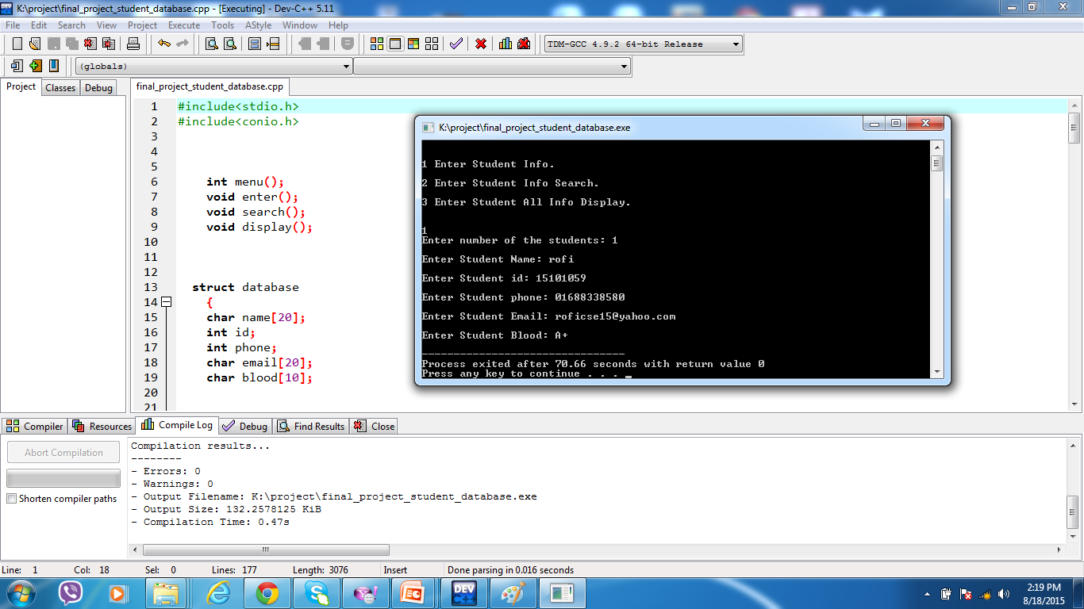
STUDENT DATA

Slide 7
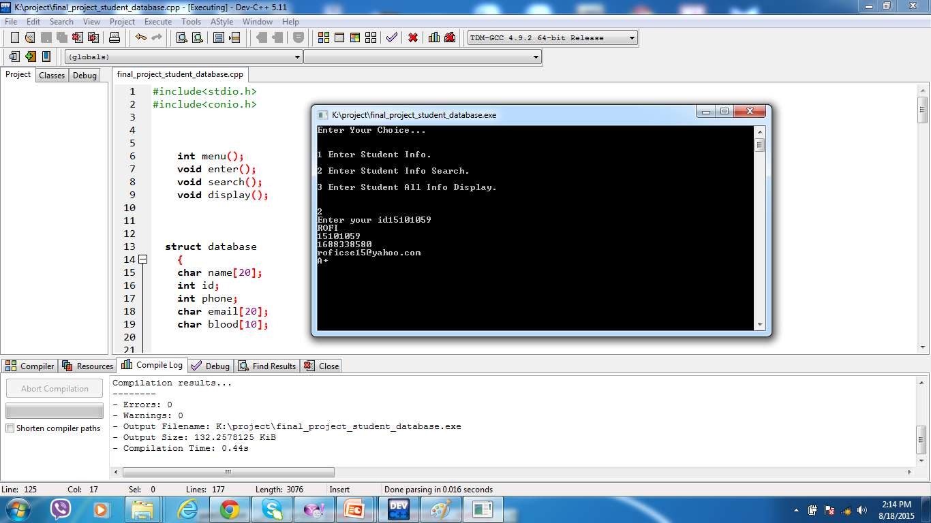
STUDENT DATA SEARCH

Slide 8
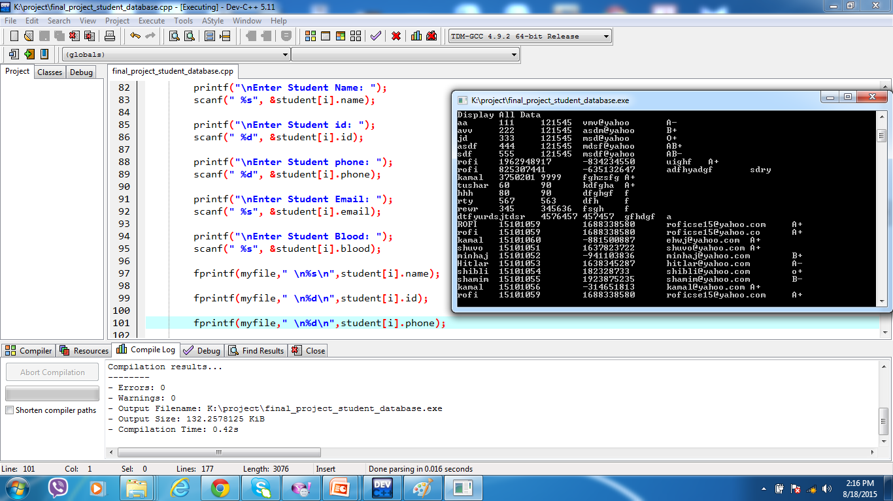
STUDENT ALL DATA SHOW

Slide 9
Future Work
While this project has supplied the basics for a system to keep track of students, many further
enhancements are desired for greater control of the information.
Big programmer
IOS developer
Want to job Google.

Slide 10
Conclusions
In conclusion, a database is a far more efficient mechanism to store and organize data than
spreadsheets; it allows for a centralized facility that can easily be modified and quickly shared among
multiple users

Slide 11
QUESTION
??

Slide 12

THANK YOU

